Slide 1

Project Sinan . Team 5
RESEARCH TOPIC
How do small business owners who import goods currently handle cross-border supplier payments - and what conditions would drive their adoption of stablecoins for these transactions?
DECISION MAKER
A Solana merchant payments startup deciding whether to target small business owners as an early adopter segment or start with a more formal business segment.
RESEARCHED & WRITTEN BY
Efe Mildred . Michael Okoro . Beulah Obadiah
July 2026

Slide 2
Project Sinan . Team 5
01
THE PROBLEM
The Problem
We investigated how small-business owners currently handle cross-border supplier payments and what conditions would drive them to adopt stablecoins for these transactions because a Solana merchant payments startup needed to know whether to target small-business owners as an early adopter segment or start with a more formal business segment.

Slide 3
Project Sinan . Team 5
02
THE METHOD
The Method
Qualitative exploratory method. We conducted semi-structured interviews with 13 active small-business importers across Lagos, Abuja, Anambra, and Edo (n=12 analyzed; 1 excluded due to audio corruption).
Analysis: We analyzed findings using open, axial, and selective thematic coding to synthesize field data into 3 distinct user personas and journey maps.
13
12
4
3
Recruited
Analyzed
States
Personas

Slide 4
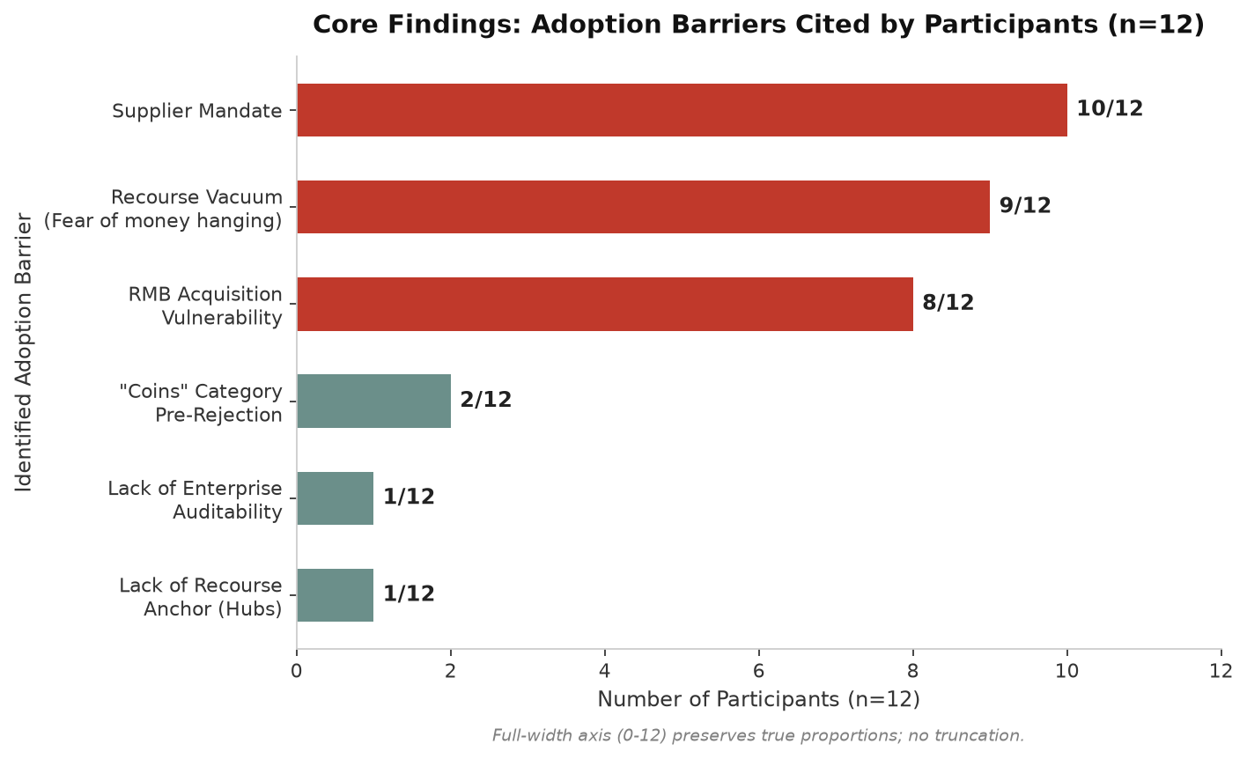
Project Sinan . Team 5
03
FINDING 01
The Supplier Mandate
Ultimate Routing Criterion
10 of 12 participants - 83%
Payment channel choice is dictated entirely by Chinese supplier acceptance (Alipay/WeChat), not user preference or platform features.
"I do not have a choice. I do not have another option. That is why I am sticking with them - not because I am loyal to them."
- Participant T4-LAG

Slide 5
Project Sinan . Team 5
04
FINDING 02
The "Recourse Vacuum"
Extreme Anxiety Over Absent Human Recourse
9 of 12 participants - 75%
Delayed transfers create extreme anxiety; traders prioritize human recourse over decentralized trustlessness.
"There is no institution to freeze the funds or no human agent to recover money if a transaction fails."
- Participant T1-LAG

Slide 6
Project Sinan . Team 5
05
FINDING 03
Segment Divergence & Enterprise Signals
1 of 12 participants - Critical formal business segment insight
Formal business importers require audit-grade documentation and ERP integration; low transaction fees alone will not drive adoption.
"If we can send an instant [payment] and confirm, and then easily link it to our books and accounting platforms, that would be very interesting and motivating."
- Participant T2-LAG

Slide 7
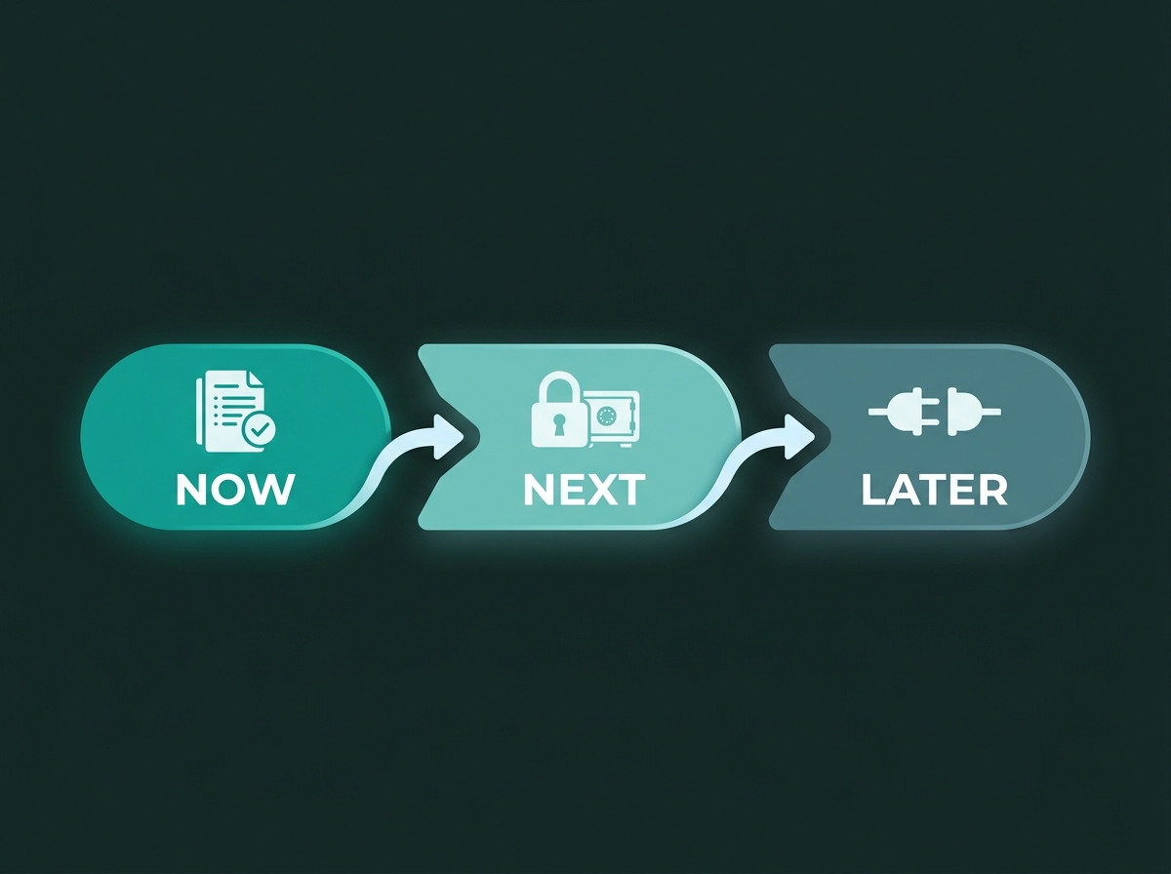
Project Sinan . Team 5
06
STRATEGIC RECOMMENDATION
Validating the Enterprise Signal
Target Decision-Maker: Head of Product
Deprioritize spend on informal small-business importers; pivot capacity to validate and build for formal business importers.
Build Audit-Grade Transaction Logs and Multi-Sig Escrow for enterprise Trust Architecture.
Success Metric: >=40% positive intent on Phase 2 validation gate (n=150) before dev rollout, targeting 30%+ cross-border TPV within 8 weeks post-feature release.

Slide 8

Project Sinan . Team 5
07
REFLECTIONS & FUTURE RESEARCH
Reflections & Future Research
What Surprised Us: Initial face-to-face field recruitment failed due to merchant skepticism, but pivoting to digital word-of-mouth through existing trusted networks successfully unlocked access to participants.
What Broke: Remote logistics and time constraints forced an online shift, scaling back our sample from 24 planned to 12 analyzed (7 women, 5 men), while budget constraints cut the quantitative survey phase and international supplier interviews.
What We'd Do Differently: Set a strict deadline for qualitative recruitment and run the quantitative survey in parallel, ensuring fieldwork bottlenecks don't compress the survey rollout.
What We'd Test Next (Phase 2): Deploy a quantitative survey of 150 informal and formal cross-border business owners to statistically validate demand for enterprise Trust Architecture, while interviewing international suppliers to solve the two-sided stablecoin adoption equation.

